Slide 1
Project 3
Group 1: Vijay, Sameer, Hail
18th March 24

Slide 2
The Story: - Electric and Hybrid vehicle (EV/ HV) usage is on the rise across the world - This story looks at sales data of EV and HV data across US - It also maps charging stations across US to see where they are concentrated - Data analytics and charging station concentration arms commercial and public decision makers to direct resources optimally - Public policy can then be directed in a certain direction - Commercial decisions can be made optimally based on current and potential sales opportunities

Slide 3
Data source Kaggel: - title={Electric &amp; Alternative Fuel Charging Stations 2023}, url={https://www.kaggle.com/ds/2375714}, DOI={10.34740/KAGGLE/DS/2375714}, publisher={Kaggle}, - title={Electric Vehicle Population}, url={https://www.kaggle.com/dsv/6687350}, Visualisations created using JavaScript / Pandas Data stored and extracted from PostgreSQL Datasets over 200,000 records merged using Pandas User driven interaction provided with API routes and Java dropdowns Final visualisation includes following views 1. Bar/ line/ pie charts 2. Heatmap 3. User interaction to explore data for specific region
How does the project address specific project requirements?

Slide 4
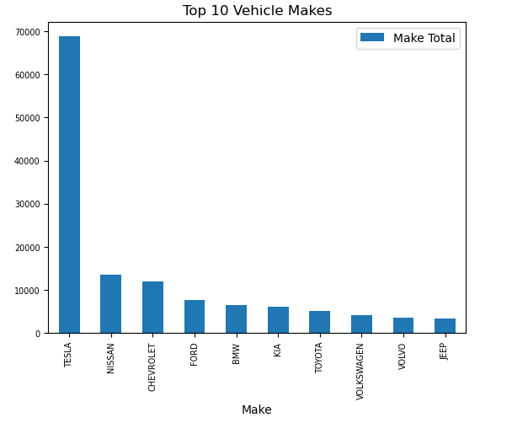
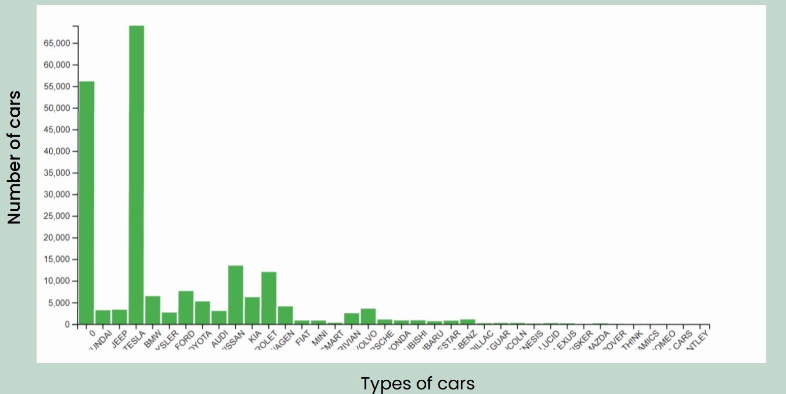
Visualisation 2: Top selling car brands in the US
Tesla dominates the market with Nissan and Chevrolet a distant second

Slide 5
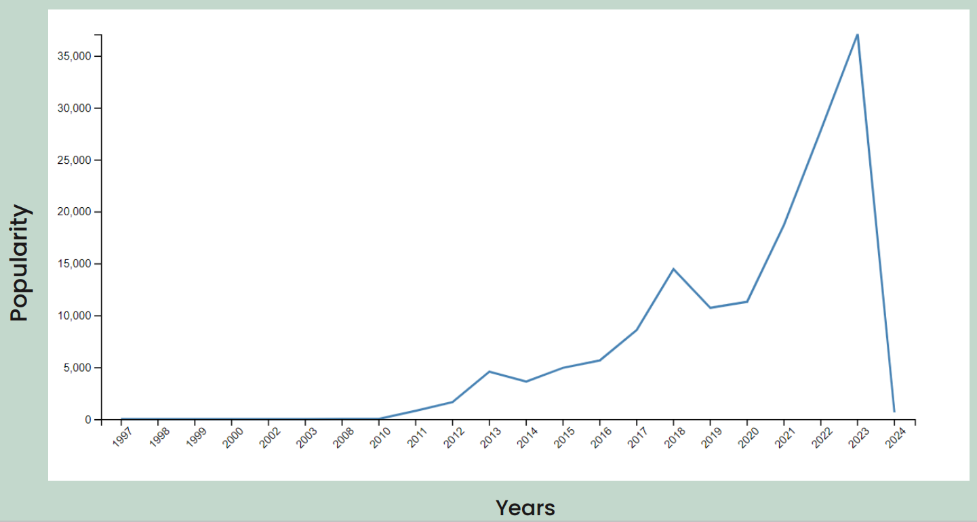
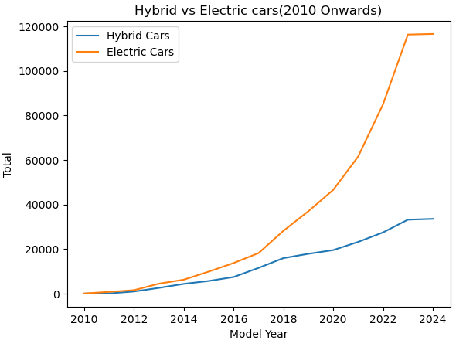
Visualisation 2: EV + HV popularity over the years
EV + HV sales have risen 600% in 10years 2013 to 2023
Left graph shows how much EV + HV models were bought every year
Right Graph shows EV and HV as a rolling total
Electric cars have an exponential growth, Hybrid cars have linear growth

Slide 6
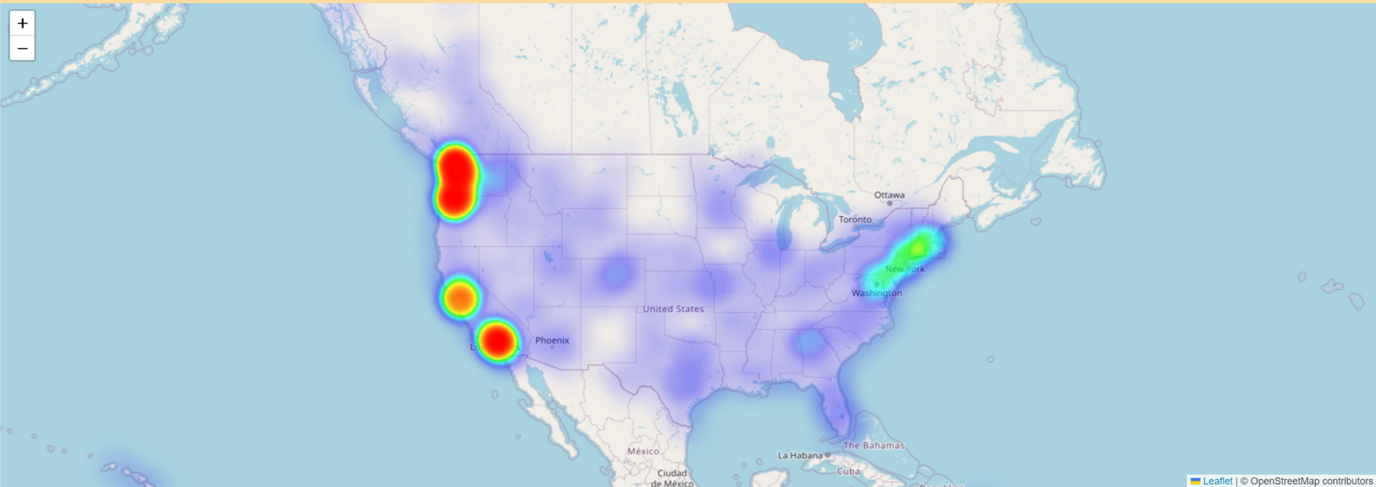
Visualisation 4: Density of charging stations across US
High density in western coastal cities
With inland density low
North Eastern coastal cities density is medium

